Slide 1

Azure Networking

Slide 2
Basics
VNET to VNET
VNET to PREM
VNET Peering
Express Route
Troubleshooting

Slide 3
Was ist Subnetting?
= Netzwerk in mehrere kleine Subnetze aufteilen
Was ist ein Subnetz?
= Teilnetz eines Netzwerkes (IP) = logische Einheit von verbundenen Netzwerkgeräten
…und warum?
Logische Gruppierung (Abteilungen, Standorte, Drucker, …) z.B. damit Nutzer nur Drucker in Ihrer Abteilung/geografischer Lokation sehen können
Notes:
Subnetting = zusammenhängenden Adressraum von IP-Adressen in mehrere kleinere Adressräume aufteilen

Slide 4
Basics
IP-Adresse: 192.168.168. 0
Subnetzmaske: 255.255.255. 0
Netzanteil
Hostanteil
IPv4 = 32-stellige Binärzahl
IPv6 = 128-stellige Binärzahl
Erste (Netzwerkadresse) und letzte (Broadcastadresse IP-Adresse eines IP-Adressbereichs können nicht vergeben werden
Anzahl von bits: | 0 | 1 | 2 | 3 | 4 | 5 | 6 | 7 | 8
Anzahl von Subnetzen: (= 2^Anzahl von bits) | 1 | 2 | 4 | 8 | 16 | 32 | 64 | 128 | 256
Notes:
- IP Adresse besteht aus Netzanteil und Hostanteil => Subnetzmaske bestimmt, an welcher Stelle die Trennung stattfindet

Slide 5
CIDR
= Classless Inter Domain Routing
Effizientere Nutzung des IPv4 Adressraums
Neue Notation für Suffixe (Netzwerk/Subnetzmaske)
Jetzt: 192.68.0.0 /24
Statt: 192.68.0.0 /255.255.255.0
/X = Anzahl an bits, die gleich 1 gesetzt werden (binäre Schreibweise der Subnetzmaske)
Beispiel: /24 => 11111111.11111111.11111111.00000000
8 + 8 + 8 = 24 (32-24=8)
Notes:
Vorher: IP Adressen wurden in Klassen aufgeteilt: the first 8 bits for class A, the first 16 for class B, and the first 24 for class C. The remainder identify hosts on that network -- more than 16 million in class A, 65,535 in class B and 254 in class C
Klasse B wurde am Meisten genutzt => die moisten Blöcke waren ungenutzt => Erschöpfung des IPv4 Raums!
CIDR lost das Problem => flexiblerer Weg um Netzwerkadressen zu spezifizieren
= Verfahren, um den IPv4 Adressraum effizienter zu nutzen

Slide 6
Beispiel
Anzahl von bits: | 0 | 1 | 2 | 3 | 4 | 5 | 6 | 7 | 8
Anzahl von Subnetzen: (= 2^Anzahl von bits) | 1 | 2 | 4 | 8 | 16 | 32 | 64 | 128 | 256
Aufgabe: Adressbereich 184.72.0.0/16, es sollen 12 Netze vergeben werden, pro Netz sollen 40 Hosts addressierbar sein.
Wie viele Adressen benötige ich für 12 Netze mit je 40 Hosts? => Subnetzmaske ermitteln
12 Netze: 2^4 = 16 Adressen sind nötig
40 Hosts: 2^6 = 64 Adresse sind nötig => 6 Bits sind für den Host reserviert
32 bit – 6 bit = 26 bits für den Netzanteil => Subnetzmaske:
Hilfsmaske anhand 1.) aufsetzen
184.72.0.000000NN.NNHHHHHH
Berechnen der Subnetze, z.B. Subnetz 10
Netzanteil berechnen Umwandeln in Binär: 10 = 1010 => NN.NN => 184.72.0.00000010.10HHHHHH
Hostanteil auf 0 setzen um Netzadresse zu ermitteln 184.72.0.00000010.10000000 => Umwandeln in Dezimal: 184.72.2.128 = Netzadresse
Hostanteil auf 1 setzen um Broadcastadresse zu ermitteln 184.72.0.00000010.10111111´ => Umwandeln in Dezimal: 184.72.2.191 = Broadcastadresse
Subnetz 10 befindet sich zwischen Netzadresse und Broadcastadresse 184.72.2.129 - 184.72.2.190
CIDR Schreibweise: /26 (32-6)
Binär: 1111111.11111111.11111111.11000000
Dezimal: 255.255.255.192

Slide 7
Ports
PPTP:
1723 TCP and Protocol 47 GRE (also known as PPTP Pass-through)
For L2TP over IPSEC:
1701 TCP and 500 UDP
For SSTP:
443 TCP

Slide 8
Policy Based vs Route based VPNs
A route based VPN creates a virtual IPSec interface, and whatever traffic hits that interface is encrypted and decrypted according to the phase 1 and phase 2 IPSec settings.
In policy based VPN the tunnel is specified within the policy itself with an action of "IPSec". Also for policy based VPN only one policy is required. A route based VPN is created with two policies, one for inbound and another for outbound with a normal "Accept" action.

Slide 9
Gatway Options
 | VPN Gateway-Durchsatz (1) | Max. IPsec-Tunnel für VPN Gateway (2) | ExpressRoute-Gateway-Durchsatz | Gemeinsame Verwendung von VPN-Gateway und ExpressRoute
Basic-SKU | 100 MBit/s | 10 | 500 MBit/s | Nein
Standard-SKU | 100 MBit/s | 10 | 1.000 MBit/s | Ja
High-Performance-SKU (3) | 200 MBit/s | 30 | 2.000 MBit/s | Ja

Slide 10
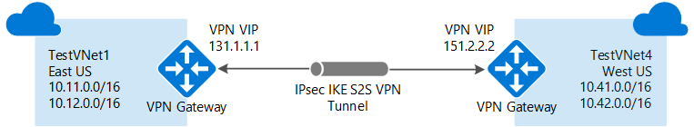
VNET To VNET (Common)
New-AzureRmResourceGroup
New-AzureRmPublicIpAddress
New-AzureRmVirtualNetworkSubnetConfig -Name 'GatewaySubnet'
New-AzureRmVirtualNetworkSubnetConfig -Name ‚WorkingSubnet‘‚
New-AzureRmVirtualNetwork -Subnet $GatwaySubnet, $WorkingSubnet
New-AzureRmVirtualNetworkGatewayIpConfig -Name gwipconfig1
-SubnetId $subnet.Id - -PublicIpAddressId $vip.Id
New-AzureRmVirtualNetworkGateway -IpConfigurations $gwipconfig `
-GatewayType Vpn `
-VpnType RouteBased `
-GatewaySku Standard
Notes:
Notes:
Ist mandatory to use the Name „GatewaySubnet“ -

Slide 11
VNET to VNET (Same Subscription)
$gateway1 = Get-AzureRmVirtualNetworkGateway -Name gateway1
$gateway2 = Get-AzureRmVirtualNetworkGateway -Name gateway2
New-AzureRmVirtualNetworkGatewayConnection -Name "vnettovnet" `
-VirtualNetworkGateway1 $gateway1 `
-VirtualNetworkGateway2 $gateway2 `
-ConnectionType Vnet2Vnet `
-SharedKey 'abcdef'
Notes:
ConnectionTypes:
Expressroute
IPSEC
VNETtoVNET
VPNCLIENT

Slide 12
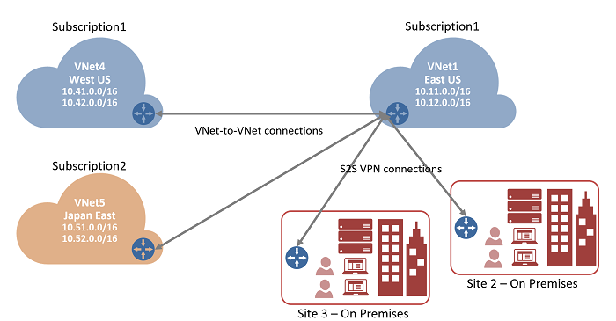
VNET to VNET (different Subscription)

Slide 13
VNET to VNET (different Subscription)
[Abbonnement 1]
$vnet1gw = Get-AzureRmVirtualNetworkGateway -Name $GWName1
$vnet1gw.Name
$vnet1gw.Id
[Abbonnement 2]
$gateway2 = New-Object Microsoft.Azure.Commands.Network.Models.PSVirtualNetworkGateway
$gateway2.Name = "VNet5GW"
$gateway2.Id = "/subscriptions/.../VNet5GW“„
New-AzureRmVirtualNetworkGatewayConnection -Name "vnettovnet" `
-VirtualNetworkGateway1 $gateway1 `
-VirtualNetworkGateway2 $gateway2 `

Slide 14
VNET to onPREM
New-AzureRmResourceGroup
New-AzureRmPublicIpAddress
New-AzureRmVirtualNetworkSubnetConfig -Name 'GatewaySubnet'
New-AzureRmVirtualNetworkSubnetConfig -Name ‚WorkingSubnet‘‚
New-AzureRmVirtualNetwork -Subnet $GatwaySubnet, $WorkingSubnet
New-AzureRmVirtualNetworkGatewayIpConfig -Name gwipconfig1 -SubnetId $subnet.Id -PublicIpAddressId $vip.Id
New-AzureRmVirtualNetworkGateway -IpConfigurations $gwipconfig -GatewayType Vpn -VpnType RouteBased `
-GatewaySku Standard
New-AzureRmLocalNetworkGateway -Name LocalSite GatewayIpAddress '23.99.221.164' -AddressPrefix '10.5.51.0/24'
New-AzureRmVirtualNetworkGatewayConnection -Name localtovon -ResourceGroupName $rgName -Location $location -VirtualNetworkGateway1 $gateway1 -LocalNetworkGateway2 $local
Notes:
Notes:
Ist mandatory to use the Name „GatewaySubnet“ -

Slide 15
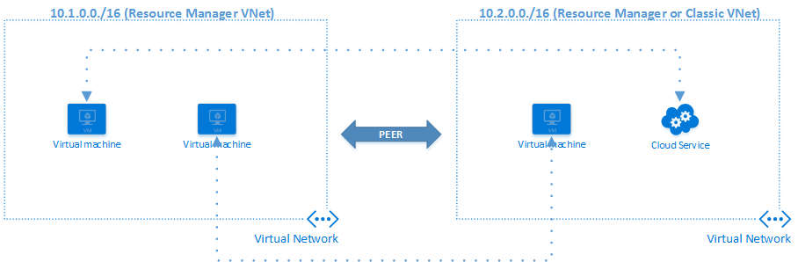
VNET Peering
VNet peering is a privileged operation.
Notes:
Requirements and key aspects of VNet peering:
The two virtual networks that are peered should be in the same Azure region.
The virtual networks that are peered should have non-overlapping IP address spaces.
VNet peering is between two virtual networks, and there is no derived transitive relationship. For example, if virtual network A is peered with virtual network B, and if virtual network B is peered with virtual network C, it does not translate to virtual network A being peered with virtual network C.
Peering can be established between virtual networks in two different subscriptions as long a privileged user of both subscriptions authorizes the peering. A virtual network that uses the Resource Manager deployment model can be peered with another virtual network that uses this model, or with a virtual network that uses the classic deployment model. However, virtual networks that use the classic deployment model can't be peered to each other.

Slide 16
VNET Peering II
During Public Preview:
Register-AzureRmProviderFeature -FeatureName AllowVnetPeering -ProviderNamespace Microsoft.Network
Register-AzureRmResourceProvider -ProviderNamespace Microsoft.Network
Get Networks:
$vnet1 = Get-AzureRmVirtualNetwork -ResourceGroupName vnet101 -Name vnet1
$vnet2 = Get-AzureRmVirtualNetwork -ResourceGroupName vnet101 -Name vnet2
Link VNET1 to VNET2:
Add-AzureRmVirtualNetworkPeering -name LinkToVNet2 -VirtualNetwork $vnet1 -RemoteVirtualNetworkId $vnet2.id
Link VNET2 to VNET1:
Add-AzureRmVirtualNetworkPeering -name LinkToVNet1 -VirtualNetwork $vnet2 -RemoteVirtualNetworkId $vnet1.id
Link VNET1 to VNET2:
Notes:
Options
AllowVirtualNetworkAccess Whether address space of Peer VNet to be included as part of the Virtual_network Tag Yes
AllowForwardedTraffic Allows traffic not originated from peered VNet is accepted or dropped No
AllowGatewayTransit Allows the peer VNet to use your VNet gateway No
UseRemoteGateways Use your peer’s VNet gateway. The peer VNet must have a gateway configured and AllowGatewayTransit is selected. You cannot use this option if you have a gateway configured No

Slide 17
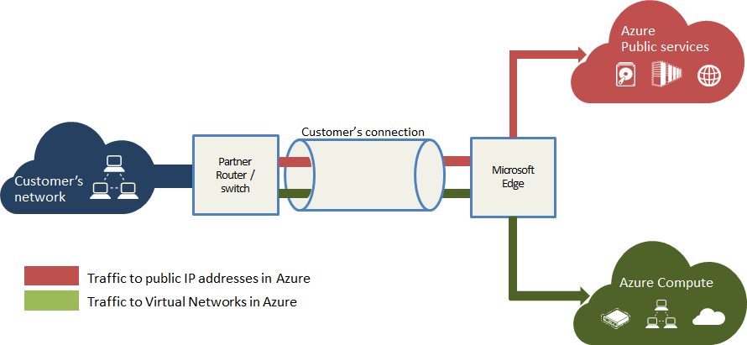
Expressroute
MBit/s
100 MBit/s
200 MBit/s
500 MBit/s
1 GBit/s
2 GBit/s
5 GBit/s
10 GBit/s
Notes:
Border Gateway Protocol …. toDo
Bei MPLS (multiprotocol Label switching) handelt es sich um ein verbindungsorientiertes Switching auf der Basis von IP-Routing und zusätzlichen Kontrollprotokollen.
https://www3.informatik.uni-wuerzburg.de/courses/vorl_03_ss/semi_internet/MPLS_UweSeiler.ppt

Slide 18
TroubleShooting VPNs
Start-AzureVirtualNetworkGatewayDiagnostics
http://blogs.technet.com/b/keithmayer/archive/2015/12/07/step-by-step-capturing-azure-resource-manager-arm-vnet-gateway-diagnostic-logs.aspx
Notes:
Note: You have to care about classic Subscription model

Slide 19
Backup

Slide 20
The PowerShell cmdlet for resetting Azure VPN gateway is Reset-AzureVNetGateway. Each Azure VPN gateway is effecticely two Virtual Machines running in an active-standby mode.
http://technet.microsoft.com/en-us/library/dd941612%28v=ws.10%29.aspx

Slide 21
IKEv2
Advantages:
Replaces eight initial exchanges with a single four-message exchange.
Reduces the latency for the IPsec SA setup and increases connection establishment speed.
Increases robustness against DOS attacks.
Improves reliability through the use of sequence numbers, acknowledgements, and error correction.
Improves reliability, as all messages are requests or responses. The initiator is responsible for retransmitting if it does not receive a response.
KeyFeatures:
Route-based VPNs / Site-to-site VPNs. / Dead peer detection / Certificate-based authentication.
AutoVPN / Dynamic endpoint VPN.
Not supported Features:
Policy-based VPN. / Dialup tunnels. / VPN monitoring. / EAP / Multiple child SAs for the same traffic selectors for each QoS value.
IP Payload Compression Protocol (IPComp). / Traffic selectors.
Notes:
Extensible Authentication Protocol (EAP)

